Slide 1

Victim Assistance Scheme Guidelines From July 2023

Slide 2

“Helping victims of serious crime by contributing to costs related to the crime, the justice process, and recovery”

Slide 3

What is the Victim Assistance Scheme (VAS)?
VAS provides financial support to victims of serious crime to alleviate the financial burden of being a victim and support participation in the justice system.
Grants are provided for:
Primary victims of serious crime, sexual violence and regulatory offences
Family/whānau of those killed by homicide, criminal act or regulatory offence
Witnesses, those first on the scene and support people.

Slide 4

Victim Assistance Scheme Guidelines
The Guidelines are the Ministry of Justice’s agreement with Victim Support for how to administer the Scheme
The Guidelines set out the:
incident categories,
grants available,
criteria and
guidance on how to apply the grants
The Guidelines apply from 1 July 2023.

Slide 5

What grants are available?

Slide 6
Incident categories and grants available
Categories
Homicide
Serious Crime
Grants
Discretionary
Counselling
Death by Criminal Act
Sexual Violence
Regulatory Offences
Court travel
Court attendance
Crime Scene Grant

Slide 7
Discretionary Grants
Contribution towards costs as a result of a crime
Not means tested, or last resort
For homicide and death by criminal act
Sexual violence supplementary grant
Sexual violence lump-sum grants are available for incidents before 1999
Serious crime – for safety and emergency costs

Slide 8
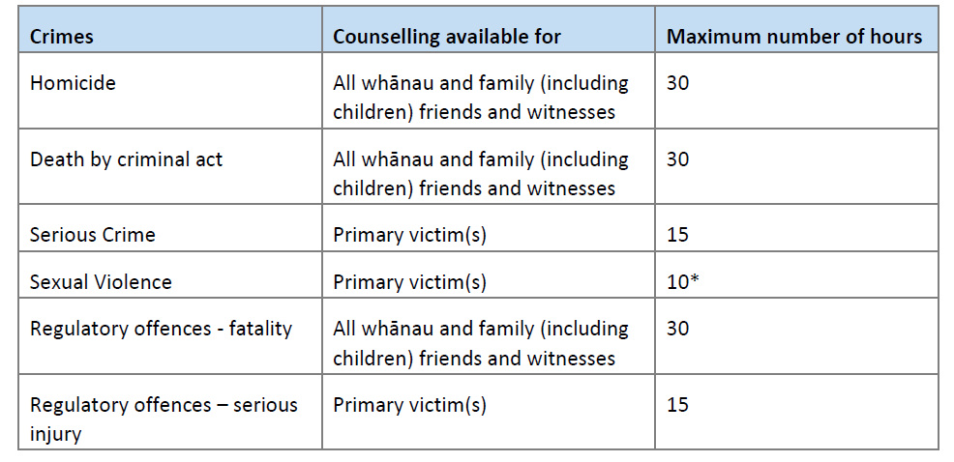
Counselling
* Counselling for SV is usually funded through ACC.

Slide 9
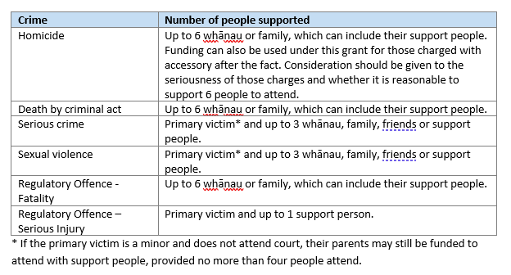
Travel Assistance

Slide 10
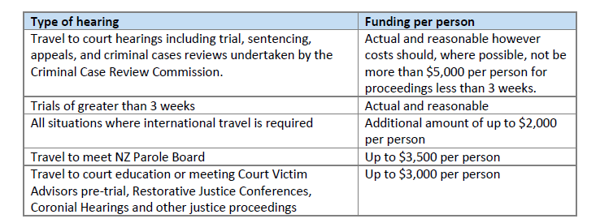
Travel Assistance
* There may be exceptional circumstances where it may be appropriate to go above this limit. Please speak to your Manager.

Slide 11
Court Attendance allowance
Available for all crime categories, except for regulatory offences
Five whanau/family/support people can claim for homicide and death by criminal act
Serious crime and sexual violence the primary victim and up to three whanau/family/support people
For sexual violence $300 ex gst/per day is available for specialist agency support people, who do not have funding to provide this support.

Slide 12
Crime Scene Grant
This grant is available when:
A police cordon has been put in place,
The Police confirm they are investigating a crime; and
The victim has been displaced; and/or
The victim’s car is not accessible.

Slide 13
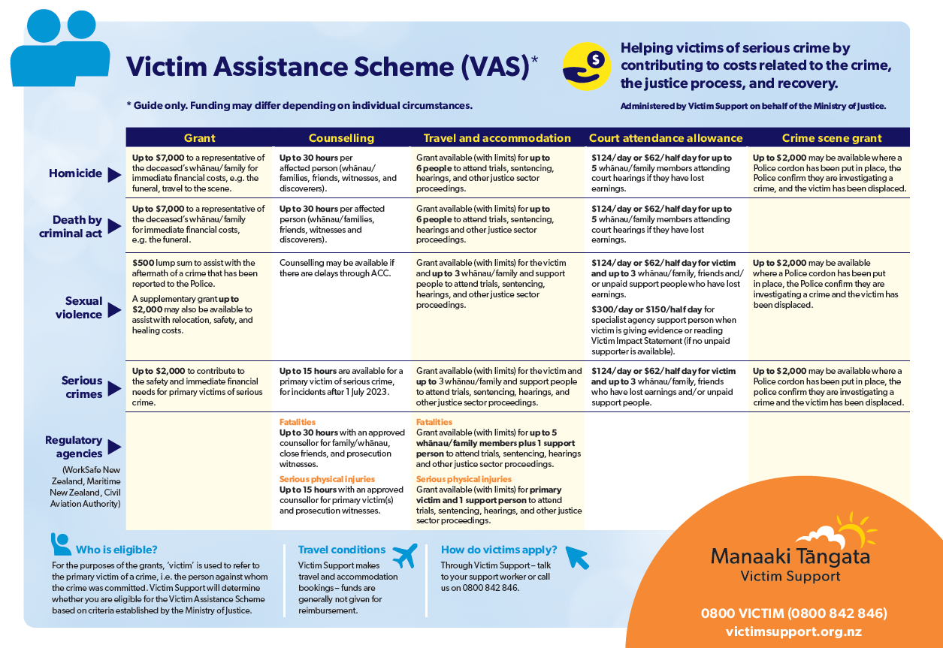
Victim Assistance Scheme Guidelines From July 2023

Slide 14
Questions

